Slide 1


Slide 2

What is Page Object Model?
It is a Design Pattern.
It is not a framework.
Also, known as POM.
This is not related to pom.xml file which we get with the Maven project.

Slide 3

What is Page Object Model? ........... (2)
Selenium documentation
Page Object is a Design Pattern that has become popular in test automation for
Enhancing Test Maintenance
Reducing code duplication.
Note: Always prefer official documentation first.

Slide 4
What is Web Page?
A web page or webpage is a document, commonly
written in HTML, that is viewed in an Internet browser.
It can be accessed by entering a URL address into a browser's address bar.

Slide 5
Web Page contains?
A Web Page can have n no. of components
Header
Footer
Side Panel
Menu Section
Banner
Example
Selenium Documentation

Slide 6
Component contains?
Components can have n no. of Web Elements
Textbox
Button
Link
Dropdown
Radio Button
Checkbox
Image

Slide 7
Different Operations on Web Elements
Click
Double Click
Right Click
Mouse Hover
Send Keys (Fill value in textbox/text area)
Drag and Drop, etc

Slide 8
Why to use Page Object Model?
Easy Maintenance
Code Re-Usability
Readability and Reliability of Scripts
Object repository is independent of test cases
It can be used in any kind of framework such as modular, data-driven, keyword-driven, hybrid framework, etc

Slide 9
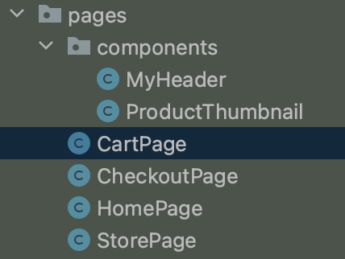
How to implement Page Object Model? - JAVA
Each Page is represented by a class
It contains the
UI element definitions
Methods for User actions.

Slide 10
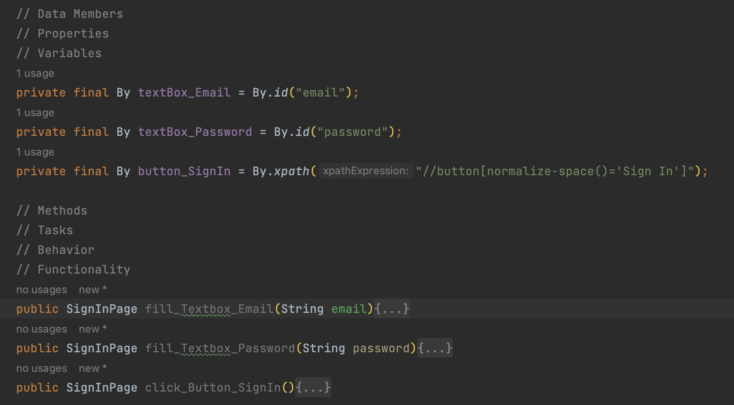
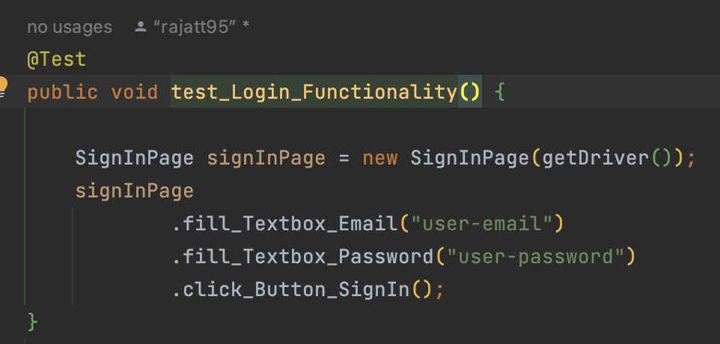
How to implement Page Object Model? - JAVA (2)

Slide 11


